Slide 1
Lecture 3: Method Parameters
Copyright (c) Pearson 2013.
All rights reserved.

Slide 2
Strings
String is a type used in Java to store literal expressions. It is NOT a primitive type.
public static void main(String[] args)
{
String x=“This is a string.”;
System.out.println(“x”); // x System.out.println(x);//This is a string.
System.out.println(“This is another string.”);
}
Output:
x
This is a string.
This is another string.

Slide 3
Method Parameters
Methods in Java can have parameters or input arguments.
Syntax:
public static void methodName(type var1)
{ <statements>} // declare
The parameters in the method header are formal parameters.
methodName(expression); // call
The parameters in the method header are actual parameters.

Slide 4
Method Parameters
Example:
public static void printDouble(int x)
{
System.out.println(“Your number ” + x + “doubled is” + 2*x +”.”);
}
To call:
printDouble(5); //Your number 5 doubled is 10.
printDouble(3.4); //Error! Incompatible types!

Slide 5
Method Parameters
Methods cannot change the values of primitive types.
public static void main(String[] args)
{
int x=3;
printDouble(4);
printDouble(x);
System.out.println(“x is now “ + x);
}
Output:
Your number 4 doubled is 8.
Your number 3 doubled is 6.
x is now 3
Note: The value of x did not change.

Slide 6
Method Parameters
Methods in Java can have return types.
public static type methodName(type var1,…, type var2)
{ <statements>} // declare
Example:
public static int doubleThis(int n)
{
int m=2*n;
return m;
// or simply return 2*n;
}
int a=doubleThis(9); //a is now 18

Slide 7
Return
public static void main(String[] args){
int x=6;
int y;
doubleThis(x); //returned value NOT SAVED!
y=doubleThis(x); // y is now 12.
System.out.println(“x doubled is “
+ doubleThis(x));
System.out.println(“x is now “ + x);
}
Output:
x doubled is 12
x is now 6

Slide 8
Value semantics
value semantics: When primitive variables (int, double) are passed as parameters, their values are copied.
  Modifying the parameter will not affect the variable passed in.
  public static void strange(int x) {
  x = x + 1;
  System.out.println("1. x = " + x);
  }
  public static void main(String[] args) {
  int x = 23;
  strange(x);
  System.out.println("2. x = " + x);
  ...
  }
Output:
1. x = 24
2. x = 23

Slide 9
Return
return: To send out a value as the result of a method.
  The opposite of a parameter:
    Parameters send information in from the caller to the method.
    Return values send information out from a method to its caller.
      A call to the method can be used as part of an expression.
-42
Math.abs(-42)
42
main
2.71
3
Math.round(2.71)

Slide 10
Common error: Not storing
Many students incorrectly think that a return statement sends a variable's name back to the calling method.
  public static void main(String[] args) {
  slope(0, 0, 6, 3);
  System.out.println("The slope is " + result); // ERROR:
  } // result not defined
  public static double slope(int x1, int x2, int y1, int y2) {
  double dy = y2 - y1;
  double dx = x2 - x1;
  double result = dy / dx;
  return result;
  }

Slide 11
Fixing the common error
Instead, returning sends the variable's value back.
  The returned value must be stored into a variable or used in an expression to be useful to the caller.
  public static void main(String[] args) {
  double s = slope(0, 0, 6, 3);
  System.out.println("The slope is " + s);
  }
  public static double slope(int x1, int x2, int y1, int y2) {
  double dy = y2 - y1;
  double dx = x2 - x1;
  double result = dy / dx;
  return result;
  }

Slide 12
Return examples
Example:
  // Returns the slope of the line between the given points.
  public static double slope(int x1, int y1, int x2, int y2) {
  double dy = y2 - y1;
  double dx = x2 - x1;
  return dy / dx;
  }
  slope(1, 3, 5, 11) returns 2.0

Slide 13
Return examples
// Converts degrees Fahrenheit to Celsius.
public static double fToC(double degreesF) {
double degreesC = 5.0 / 9.0 * (degreesF - 32);
return degreesC;
}
// Computes triangle hypotenuse length given its side lengths.
public static double hypotenuse(int a, int b) {
double c = Math.sqrt(a * a + b * b);
return c;
}
You can shorten the examples by returning an expression:
  public static double fToC(double degreesF) {
  return 5.0 / 9.0 * (degreesF - 32);
  }

Slide 14
Find the errors
Public class Parameters{
public static void main(String[] args){
double bubble=867.53, x=10.01, y=5.3;
printer(double x, double y);
printer(x);
printer(“barack”, “obama”);
System.out.println(“z = “ + z);
}
public static void printer(x, y){
int z = 5;
System.out.println(“x = “ + double x+ “ and y= “+y);
System.out.println(“The value from main is “+bubble);
.}}

Slide 15
Find the errors
Public class Parameters{
public static void main(String[] args){
double bubble=867.53, x=10.01, y=5.3;
printer(double x, double y);
printer(x); // need two arguments.
printer(“barack”, “obama”);// not right types
System.out.println(“z = “ + z);// z is local to //printer
}
public static void printer(x, y){
int z = 5;
System.out.println(“x = “ + double x+ “ and y= “+y);
System.out.println(“The value from main is “+bubble);
}}

Slide 16
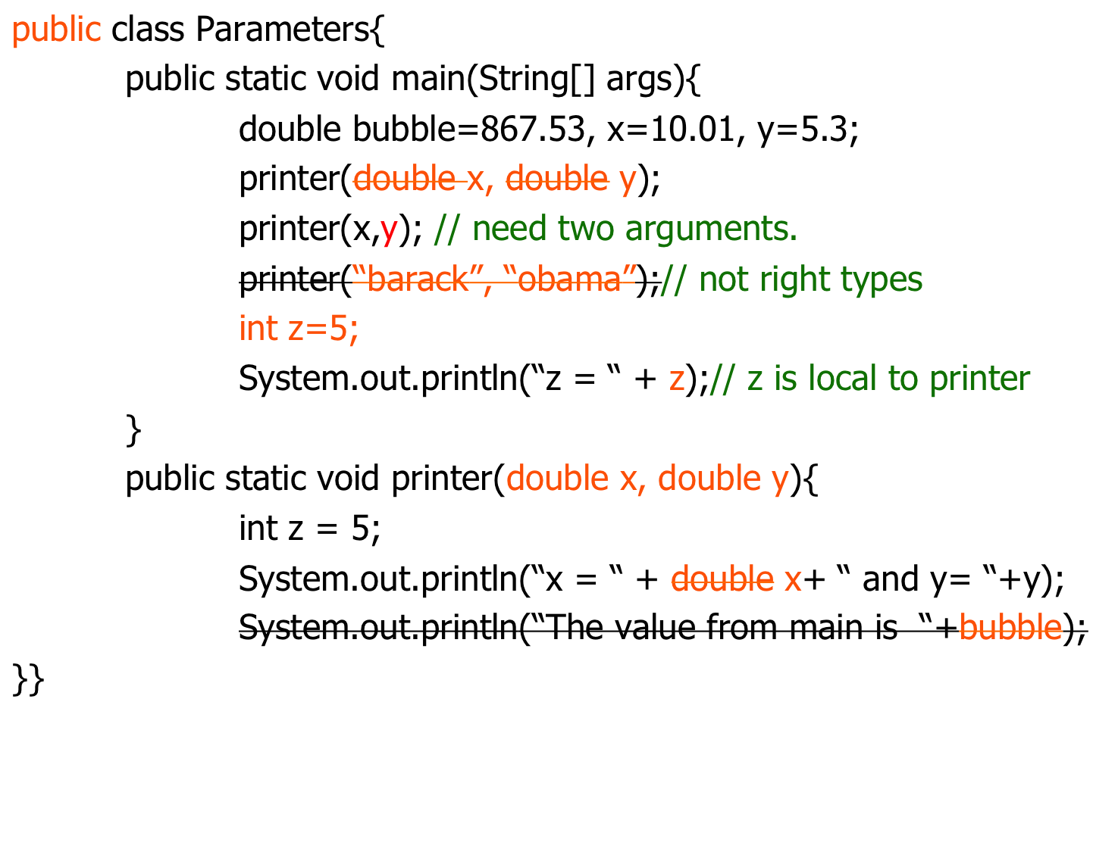
Corrected Version

Slide 17
Lab
Write a class with the following five static methods.
// given two integers x and y, returns their average.
public static double average(int x, int y)
{…}
// given two points (x1, y1) and (x2,y2), returns
// the slope of the line through them. You may assume
// x1 is not equal to x2.
public static double slope(int x1,int y1,int x2,int y2)
{…}

Slide 18
Lab
// given two integers x and y, returns the difference x-y
public static int difference(int x, int y)
{…}
// given an integer x returns its square x*x.
public static int square(int x)
{…}
// given two points on the plane, returns the distance between them.
// You MUST CALL the methods difference and square above.
// In addition, you CANNOT use subtraction nor multiplication in this method.
public static double distance(int x1, int y1, int x2, int y2)
{…}

Slide 19

Lab
Write your main() method so that your program has an output similar to:
Notice the format of the points on the coordinate plane.

Slide 20
Lab 2
Modify the previous program by adding a method printMath so that the call
printMath(8,9,2,4);
Gives the output:
Use the following method header:
public static void printMath(int x, int y, int a, int b) {…}

